Slide 1
.NET
Sprint-1
Online shopping management system

Slide 2
Proposed System
This project contains two modules
I. Admin:
In this module administrator has to add, update and delete the details of the Product.
II. Users
In this users can see and buy the product and register new user.

Slide 3
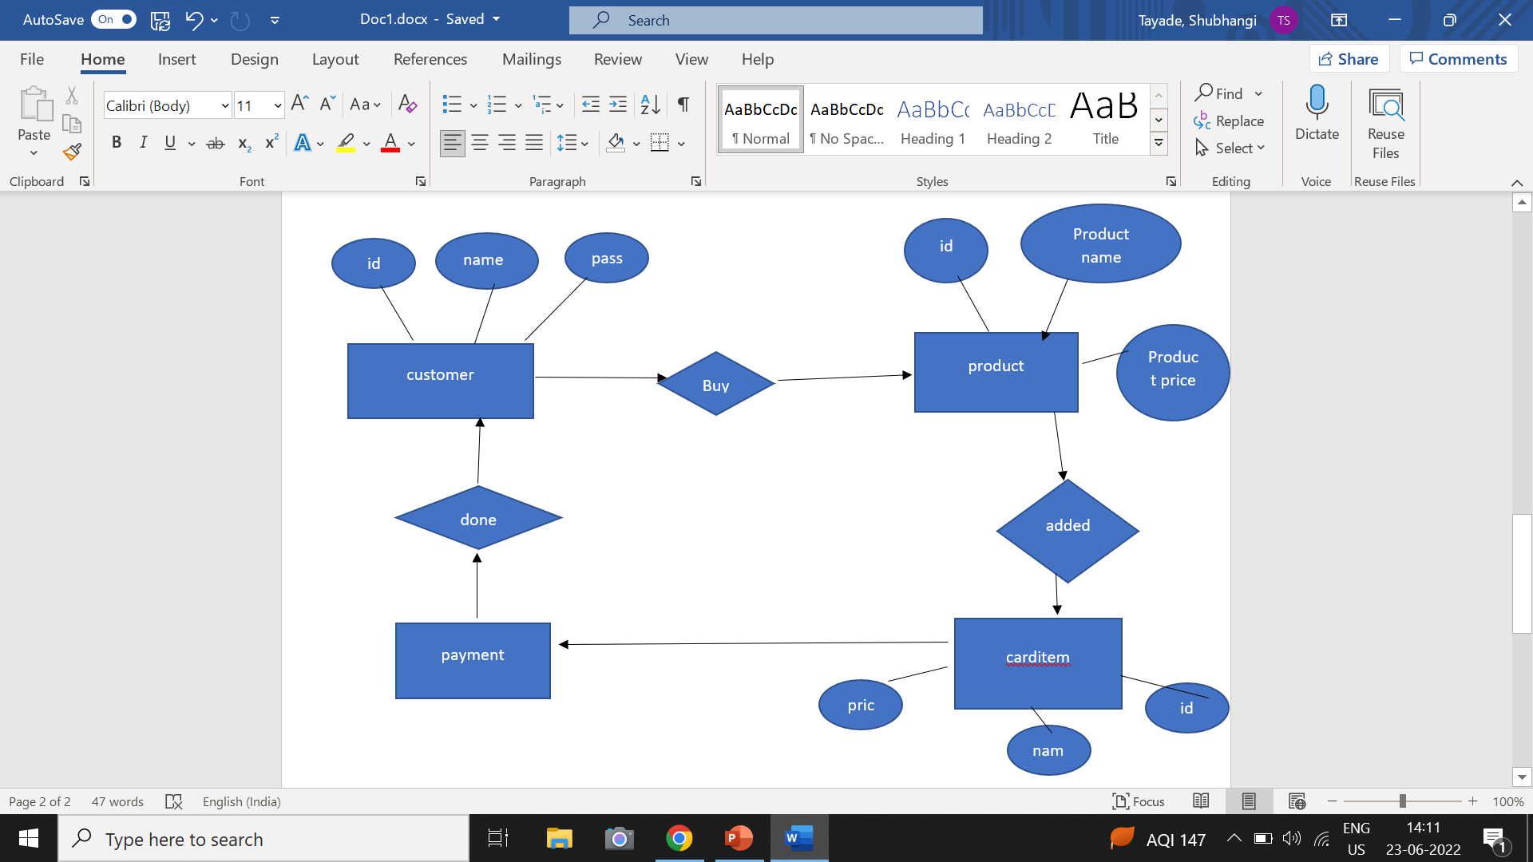
ERdiagram

Slide 4
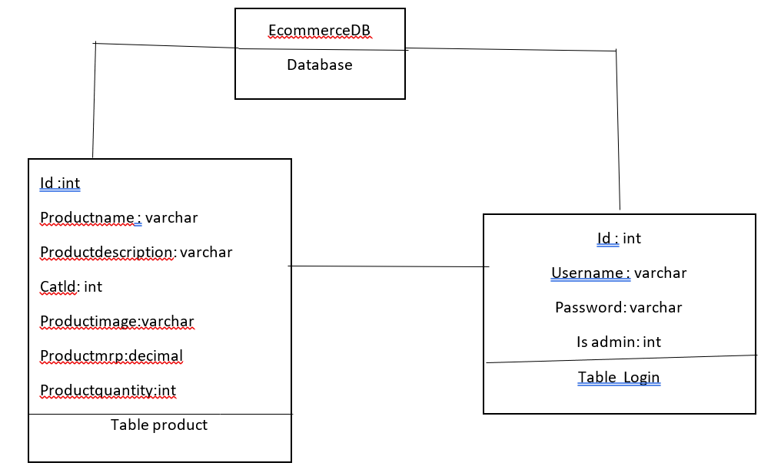
Database diagram for Ecommerce

Slide 5
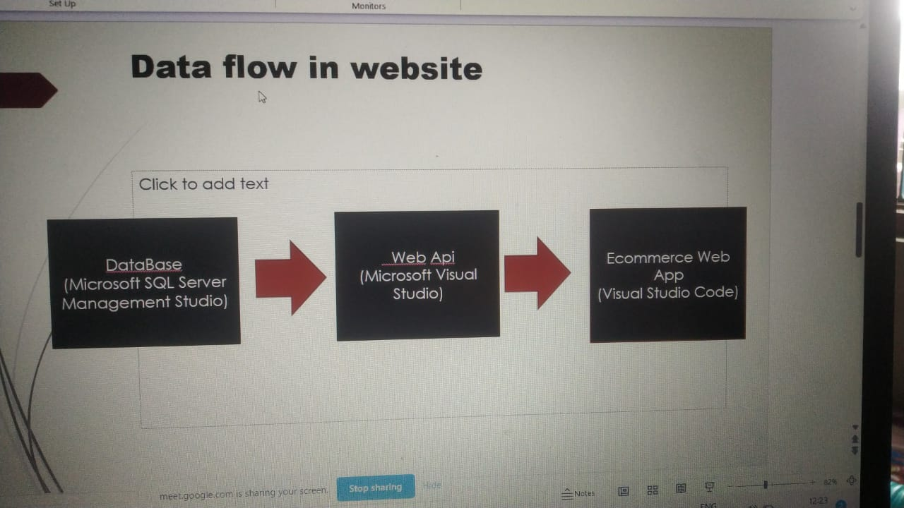
Data Flow In Website

Slide 6
Features
1.Customer Module
The customer module allows users to register,login and logout.The customer collect all information like Product.
2.Admin Module
The admin is maintain the user details product name ,product id, product price Admin can add

Slide 7
THANK YOU

